Slide 1



“Employee Management System”
Submitted by: Neha C. Dangat
Submission type : Individual
Name: Neha Dangat
Batch : 1
LMS Id : nehadangat17@gmail.com
Program : HDFC Bank API Training Program
Date: 25/04/2023

Slide 2

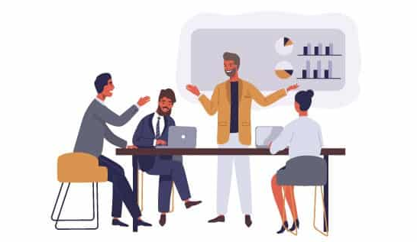
Table of contents
Introduction
Project Overview
Architecture Design
User Interface Design
Back-end Development
Front-end Development
Testing
Deployment
Conclusion
Future Work
References

Slide 3

Introduction
The project involves creating a database table with three columns - EmployeeID, EmployeeName, and DateOfBirth. The project requires writing code in Java to query a single record based on EmployeeID and returning an error message if the ID does not exist. The code must be stored in a Git repository and deployed using Jenkins to an application server like Tomcat or WebLogic. The Java code will then be modified to expose the service as a HTTP web service that accepts EmployeeID and returns all three fields. The web service will log each call with date-timestamp and rotate the log file if it exceeds 1MB. The service will be called from Postman, and then changed to use HTTPS with a self-signed certificate. A CURL command will be written to call the service, and a separate Java client program will also be written to call the service. The DateOfBirth field will be encrypted using AES-256, and the client program will be updated to decrypt the value.

Slide 4
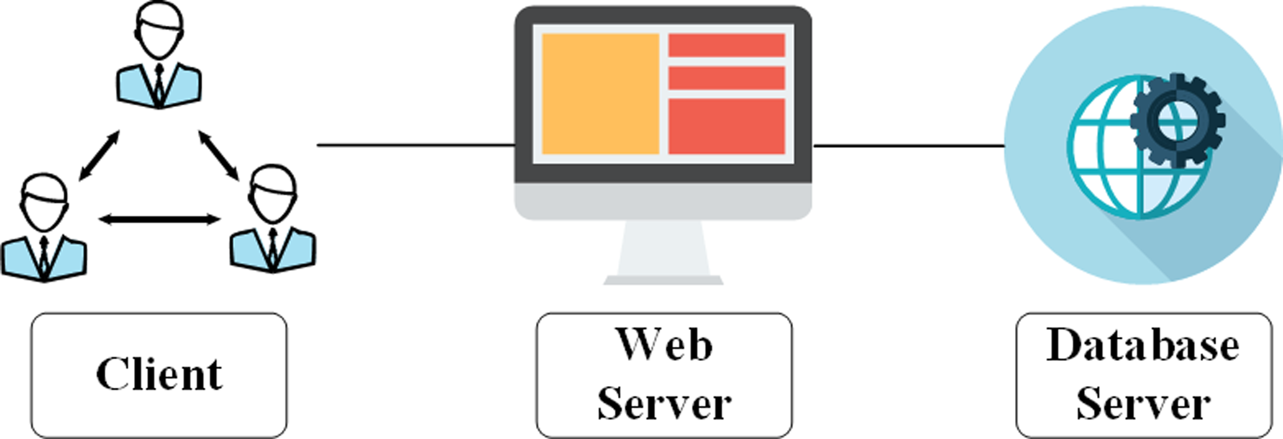
Project Overview
This project involves creating a table in a database with three columns: EmployeeID, EmployeeName, and DateOfBirth. Then, Java code will be written to query a single record based on the EmployeeID, with an invalid EmployeeID error returned if there is no match. The code will be stored in a repository, such as Git, and deployed using Jenkins to an application server like Tomcat or WebLogic.
Next, the Java code will be modified to expose the query functionality as an HTTP web service that accepts an EmployeeID and returns all three fields of the corresponding employee. The web service will also create a log file with a date-timestamp for every call and will rotate the log file if its size exceeds 1MB.
The web service will be tested by calling it from Postman. Then, the web service will be updated to use HTTPS and a self-signed certificate, and tested again with Postman. A CURL command will also be written to call the web service.
A separate Java client program will be created to call the web service. The web service will be updated to encrypt the DateOfBirth using AES-256, and the client program will be updated to decrypt this encrypted value.

Slide 5
Architecture Design
Starting Point
Database Server
Spring Boot App
Git Repo
Jenkins
Web Server
HTTPS
Postman
Logging
HTTP Web Service
AES-256 Encryption
Docker Container
Kubernetes
Java Client

Slide 6
User Interface Design
class Employee
int employeeId; String employeeName; String dateOfBirth;
//getter and setter methods
class client
int employeeId; String employeeName; String dateOfBirth;
//getter and setter methods
Employee
Get
Employee
Info
Client
Using restTemplet
service
getEmployeeByEmployeeId
service
getEmployeeByEmployeeId
Use Case Diagram

Slide 7

Back-end Development
The back-end development project involves creating a database table with three columns (EmployeeID, EmployeeName, DateOfBirth).
writing Java code to query a single record based on EmployeeID, and deploying the code to an application server such as Tomcat or WebLogic using Jenkins.
The Java code should be modified to expose a web service that accepts a single EmployeeID and returns all three fields of that Employee.
The web service should print a log file with a date-timestamp for every time it is called, and the log file should be rotated if its size exceeds 1 MB.
The web service should be changed from HTTP to HTTPS using a
self-signed certificate, and a CURL command and a Java client
program should be written to call the web service.
The DateOfBirth field should be encrypted using
AES-256, and the client program should be updated
to decrypt the encrypted value.

Slide 8
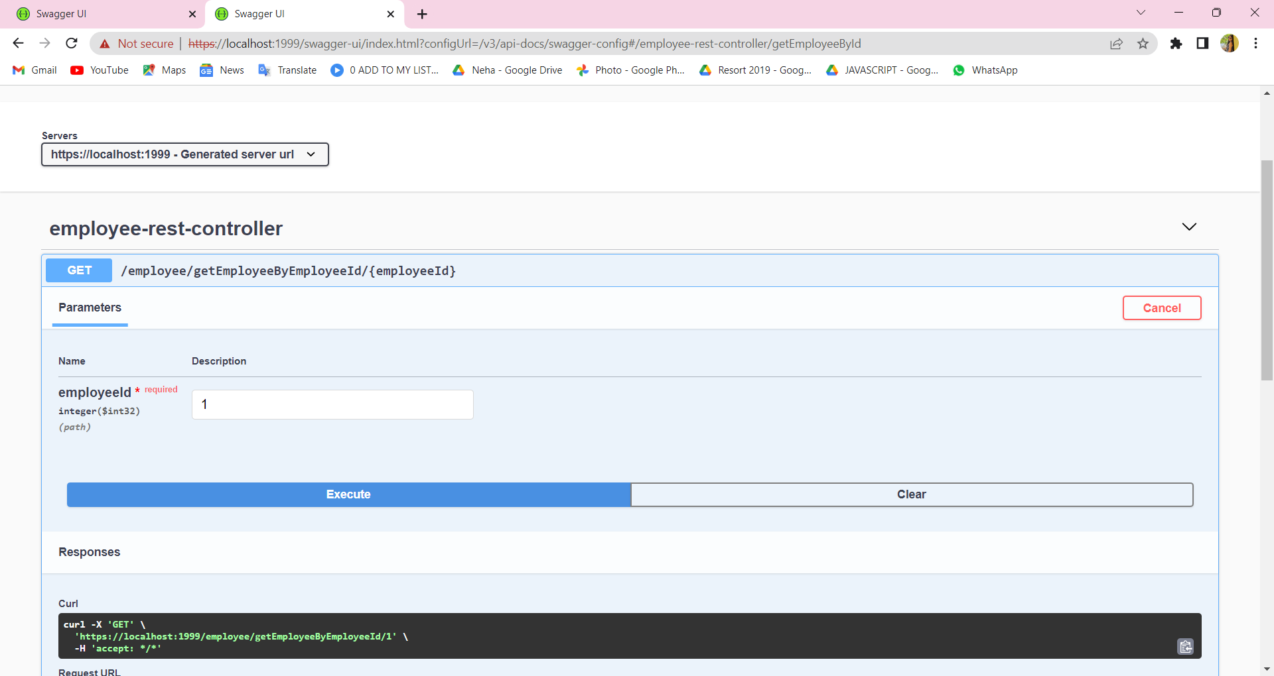
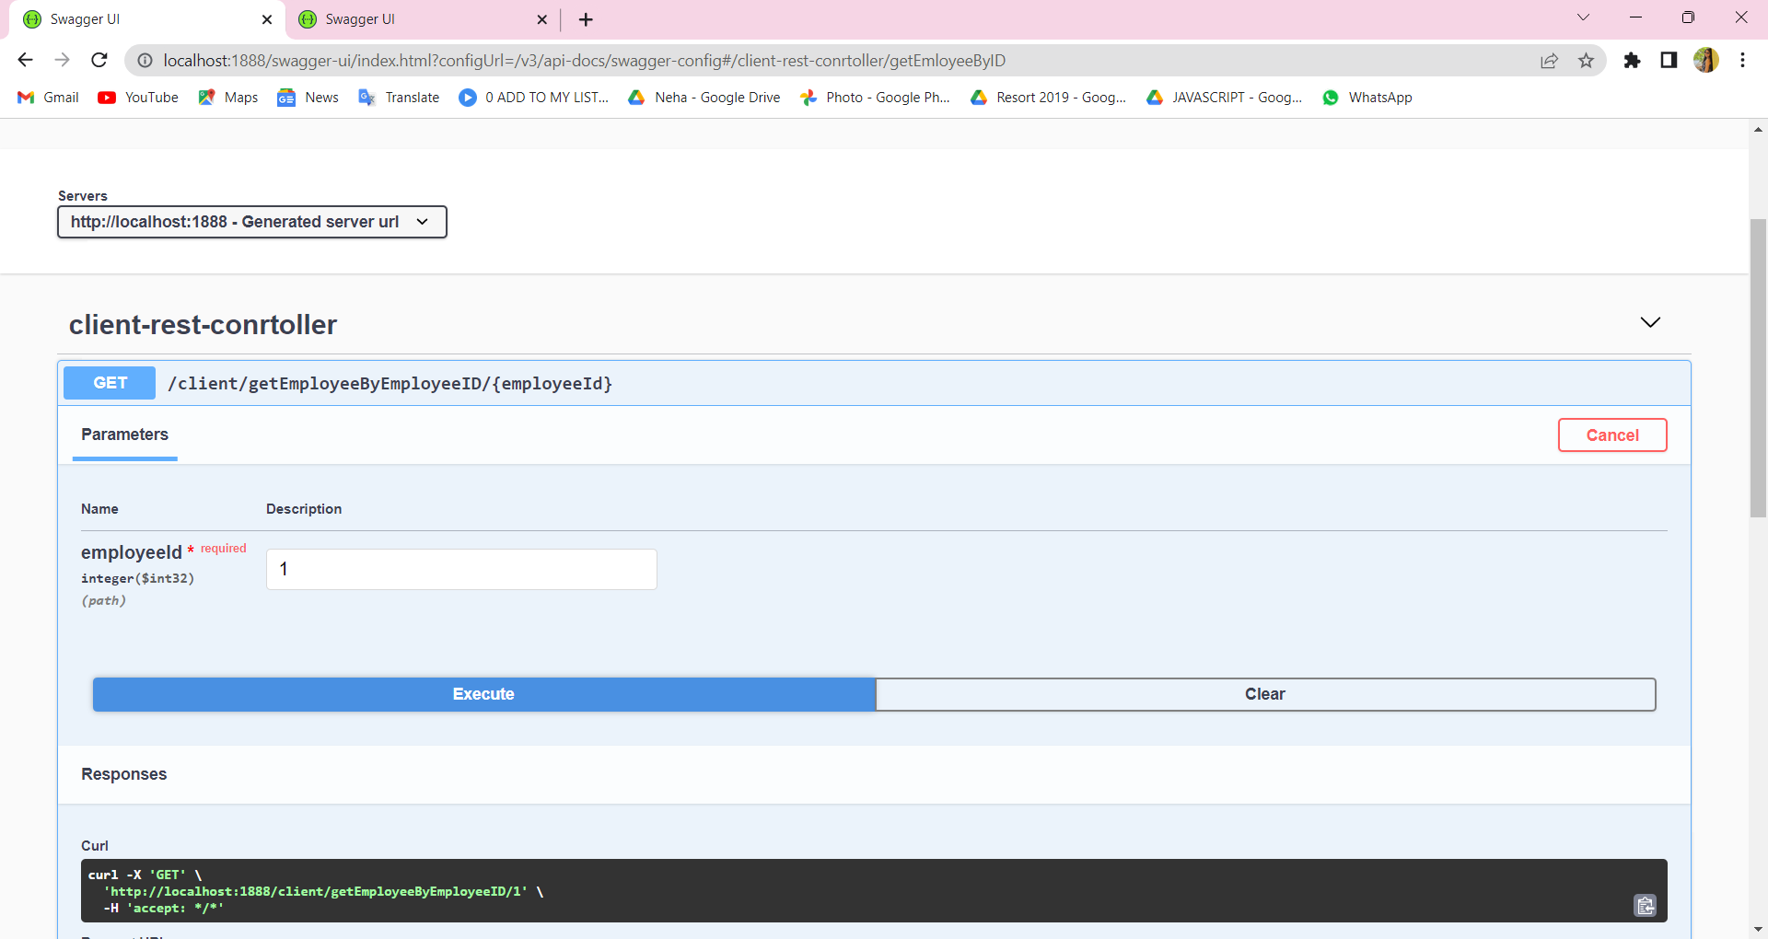
Front-end Development

Slide 9
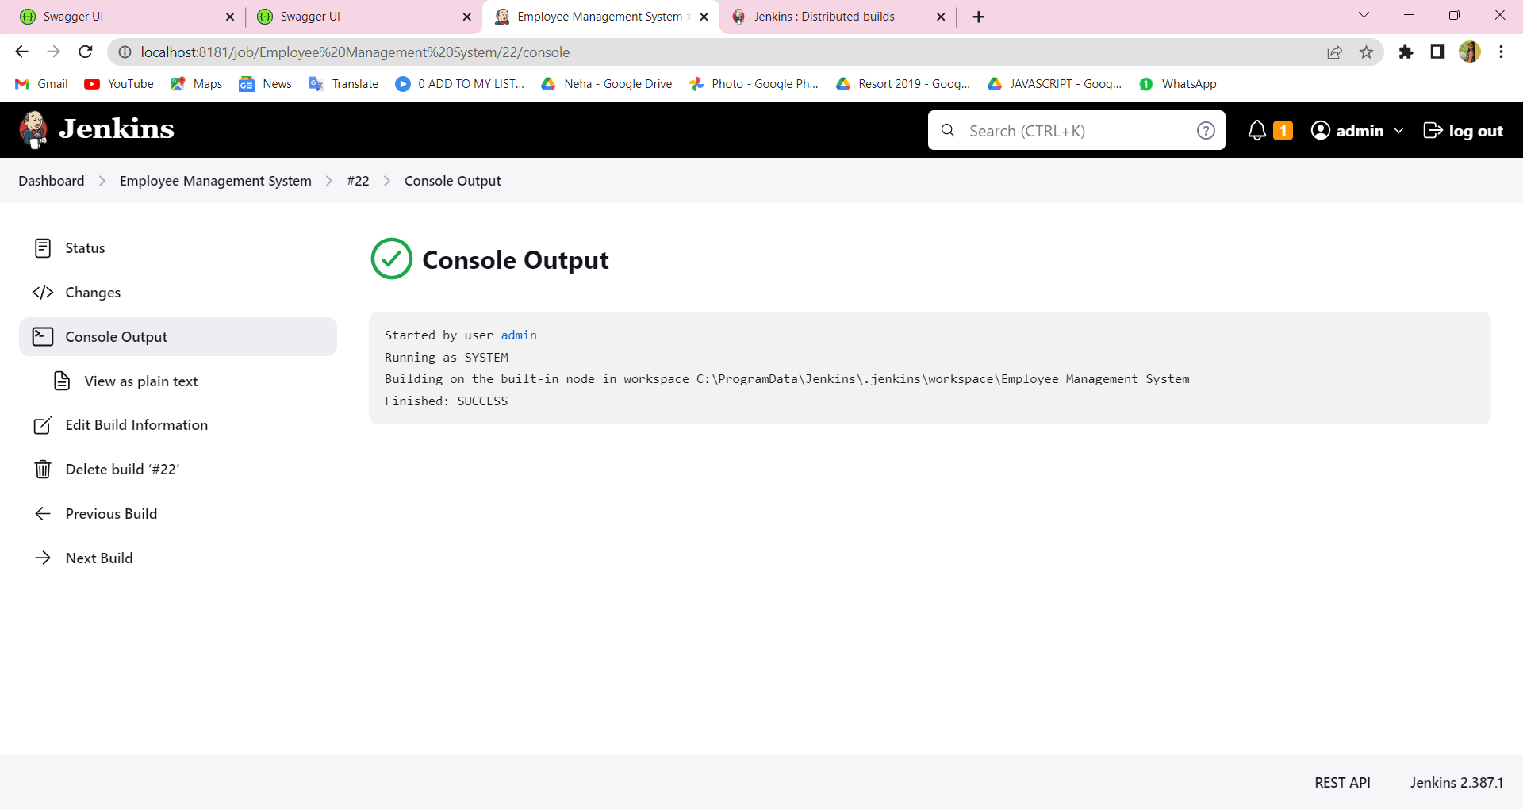
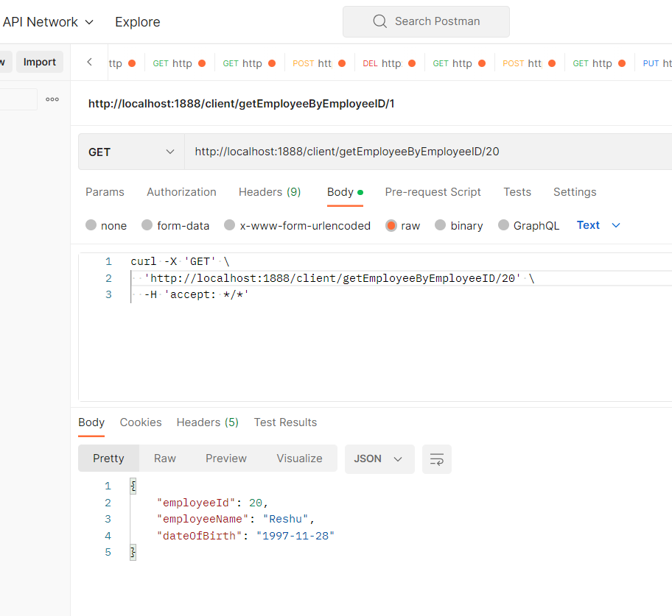
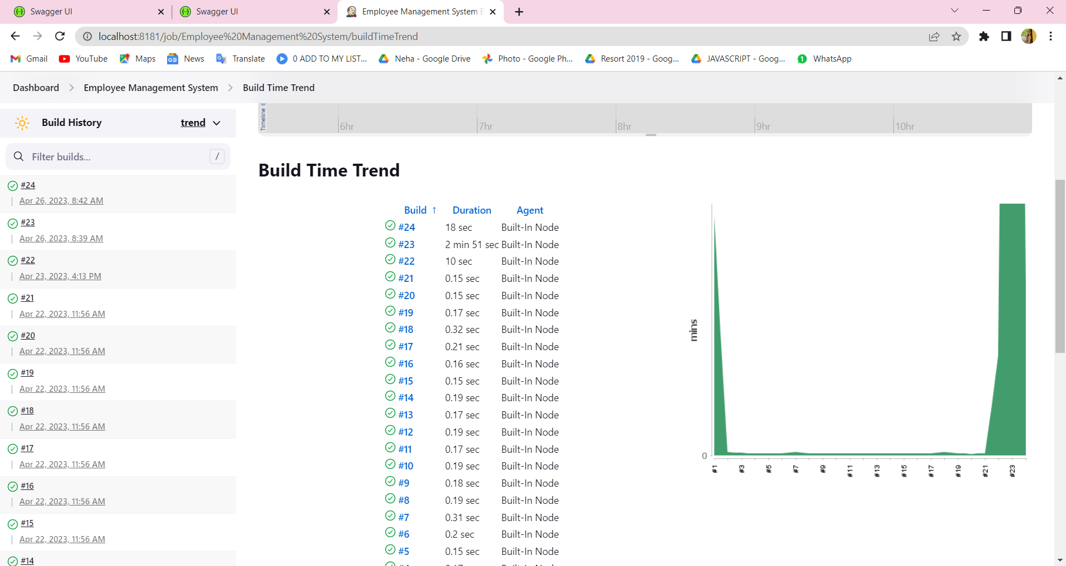
Front-end Development

Slide 10
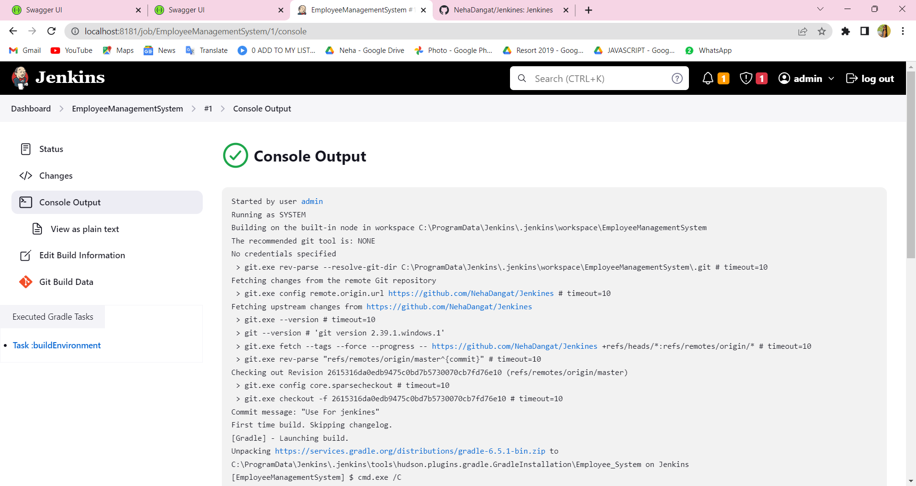
Front-end Development

Slide 11
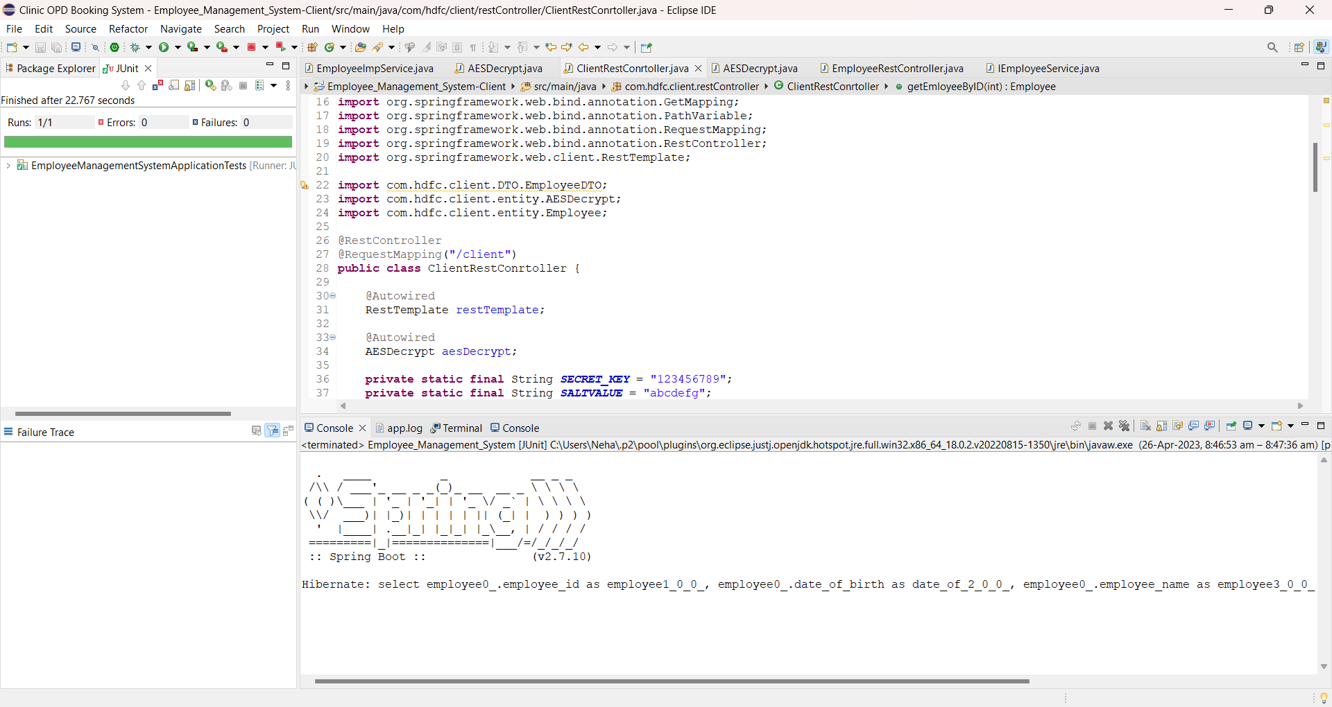
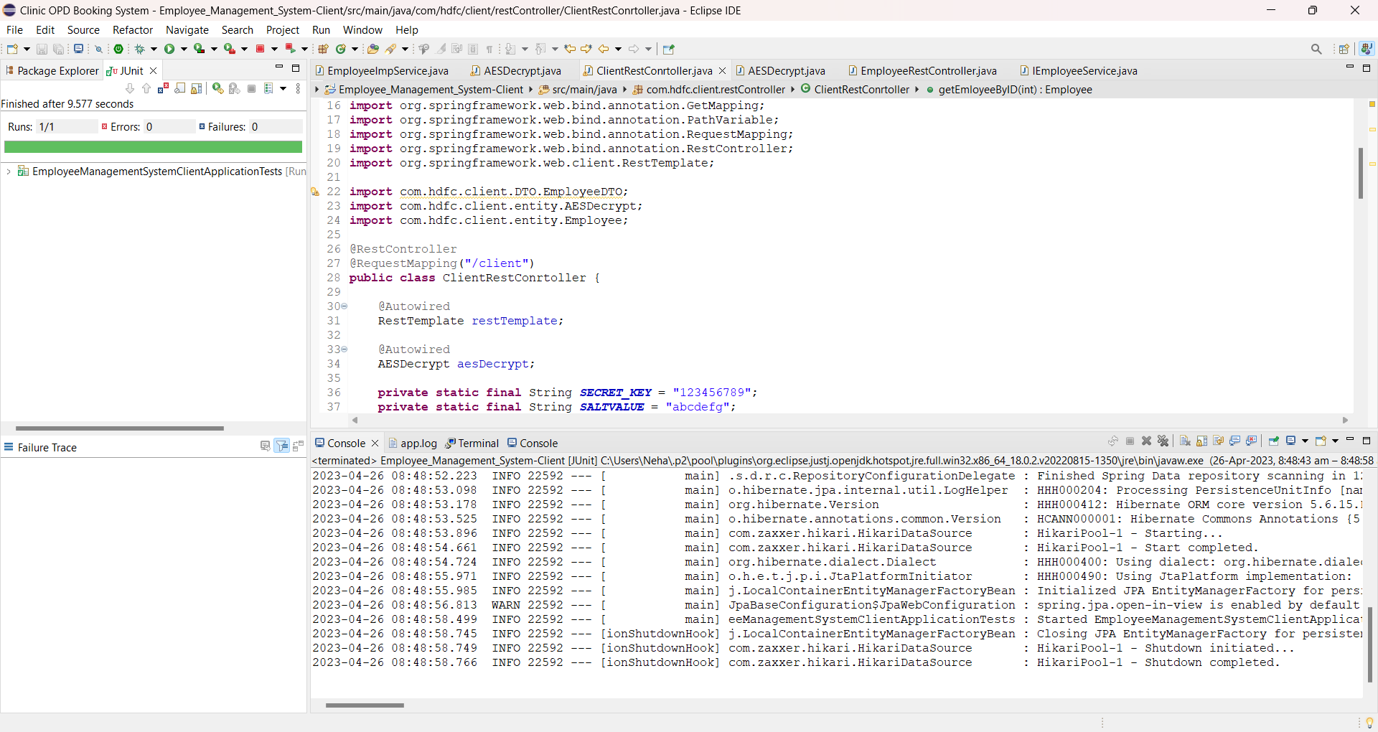
Integration and Testing
Integration testing: Test the web service by calling it with valid and invalid EmployeeIDs to ensure that the correct Employee record is returned, and invalid EmployeeID errors are handled appropriately. Also, test the logging feature to verify that logs are created and rotated correctly.
Client testing: Test the Java client program by calling the web service with valid and invalid EmployeeIDs and verifying that the decrypted DateOfBirth value is correct. Test the client program's error handling by passing invalid inputs and verifying that errors are handled correctly.

Slide 12








Deployment
Install the necessary software dependencies, such as Java, Spring boot, and any other required libraries.
Deploy the application to the application server, such as Tomcat or WebLogic, either manually or using Jenkins.
Test the application by calling the web service from Postman or a client program, verifying that it returns the correct results and logs the calls to a file.
Configure the application server to enable HTTPS, generate a self-signed certificate, and configure the application to use the certificate.
Re-test the application using Postman, verifying that it can now be accessed securely over HTTPS..
Write a Java client program to call the web service and test it.
Update the client program to decrypt the encrypted DateOfBirth value.
Build a containerized version of the application using a tool such as Docker.

Slide 13
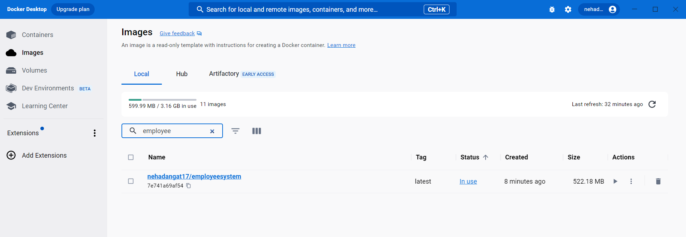
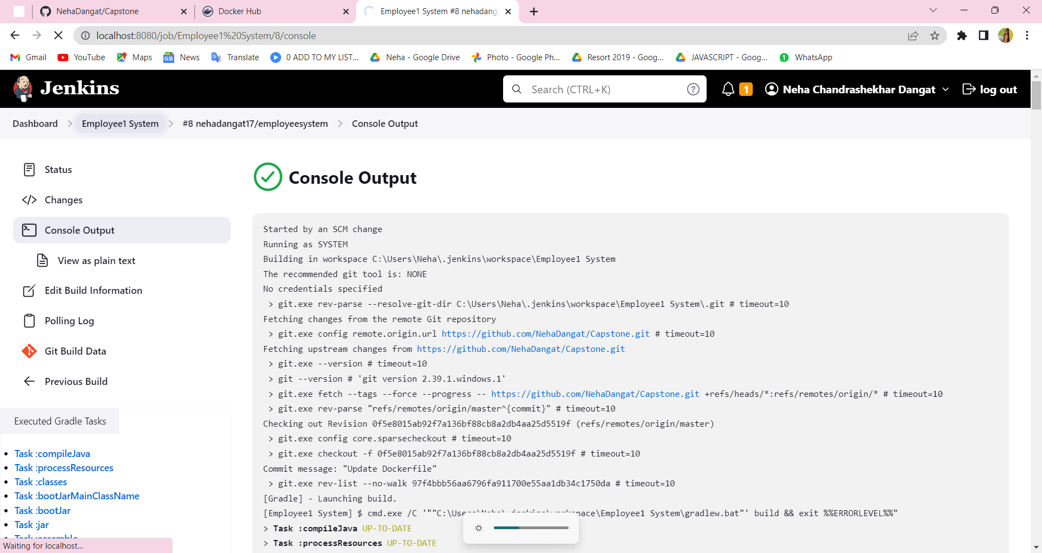
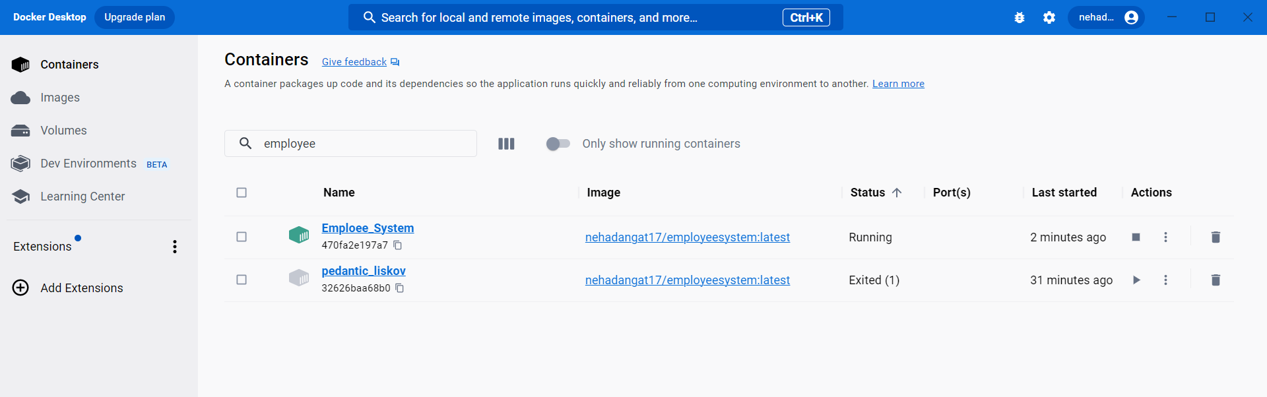
Deployment
Docker Image
Jenkins Console
Docker Container

Slide 14
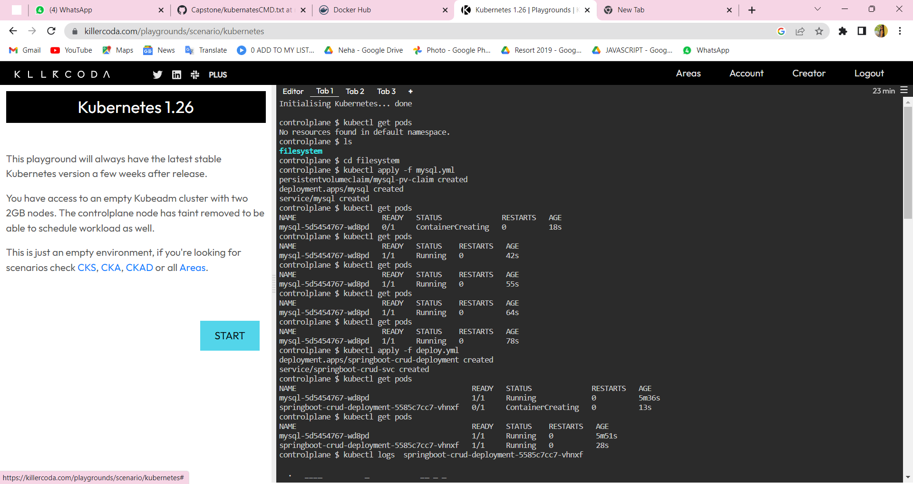
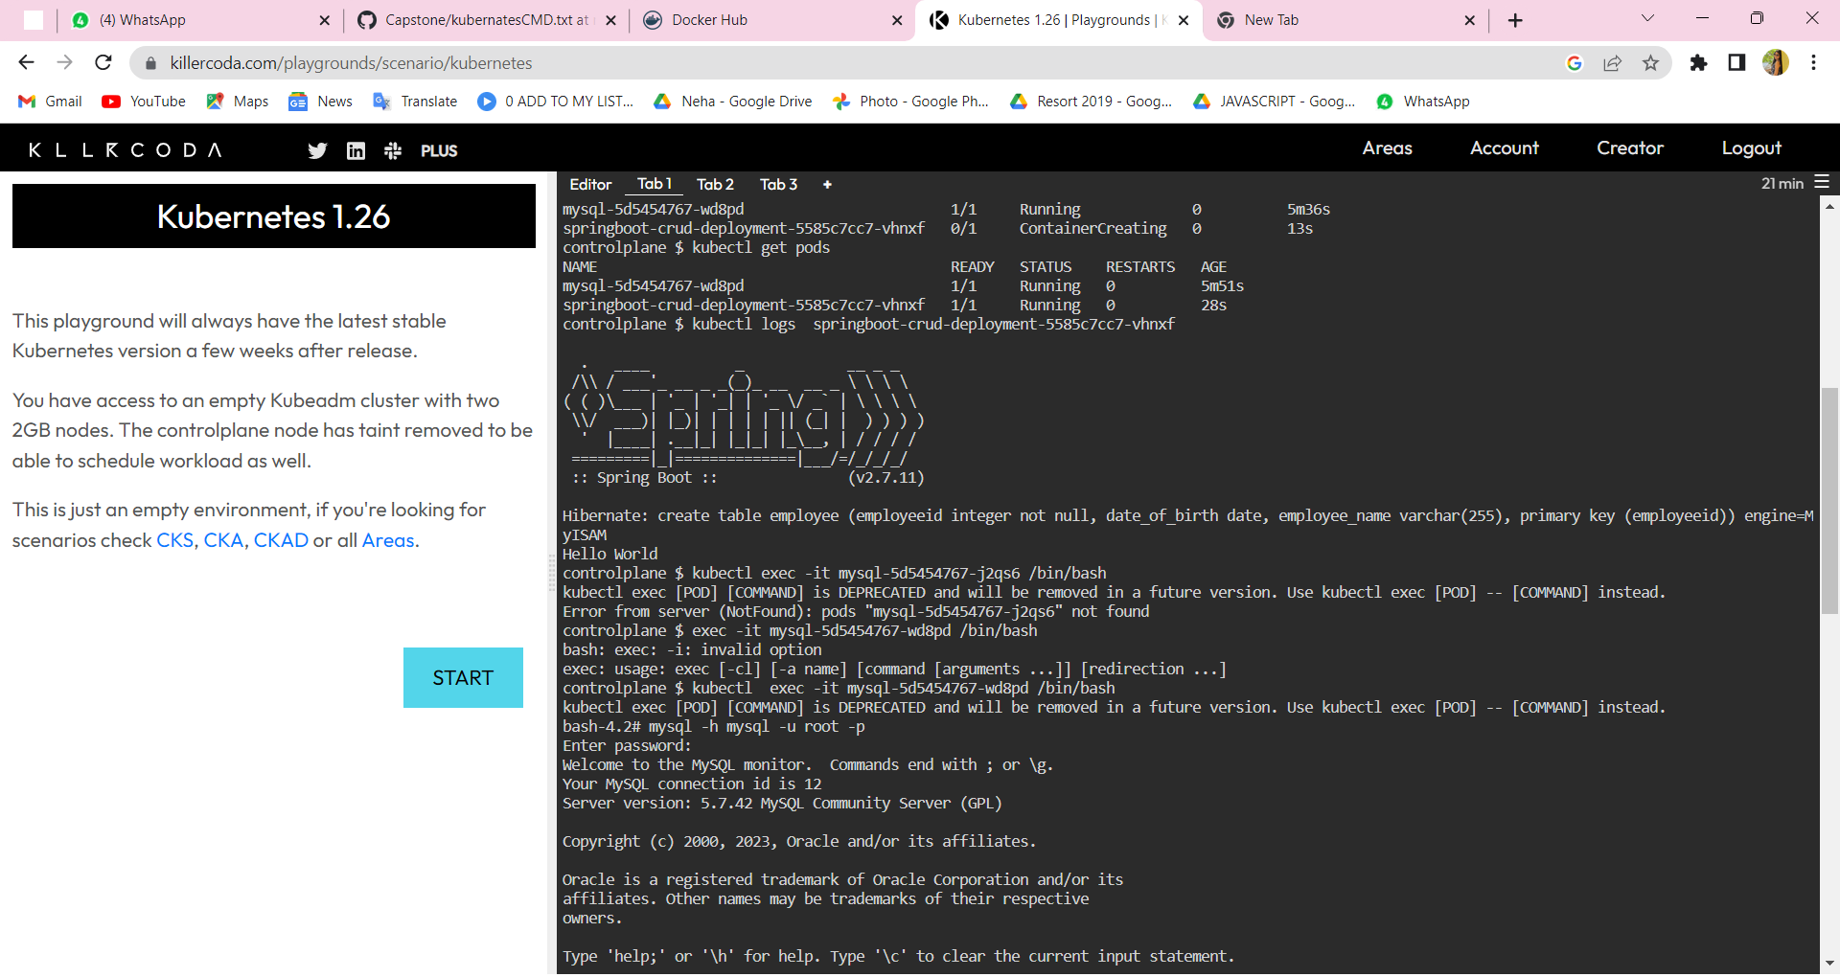
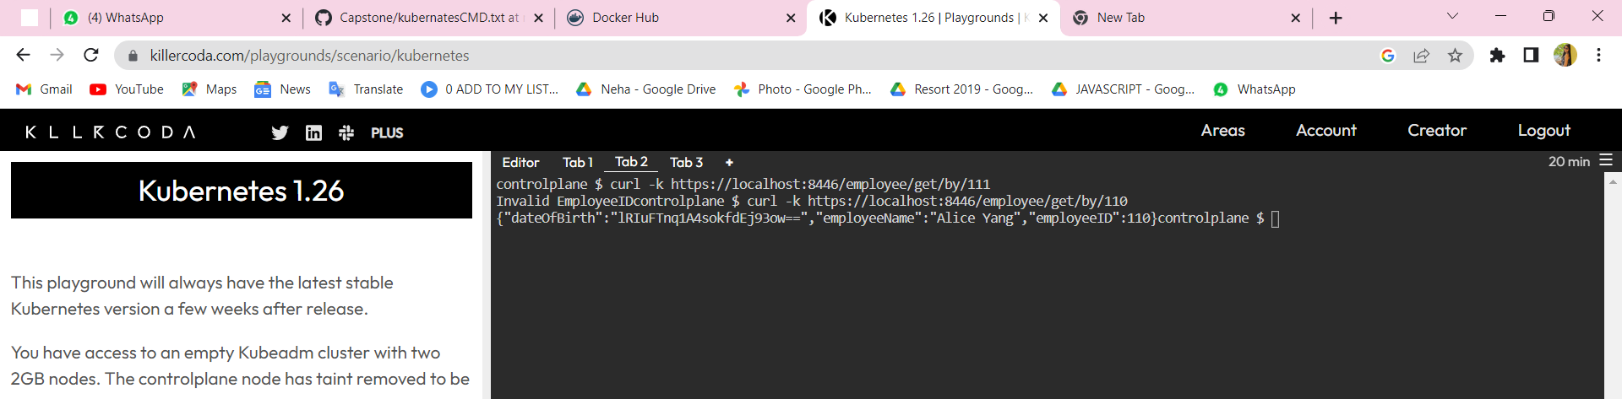
Deployment
Minikube

Slide 15

Conclusion
In conclusion, we have successfully created a table Employee with 3 columns in a database and written Java code to query a single record based upon EmployeeID. We have also exposed the code as an HTTP web service, implemented logging, and enabled HTTPS with a self-signed certificate. We have tested the web service using Postman, written a CURL command and a separate Java client program to call the web service. Additionally, we have encrypted the DateOfBirth field using AES-256 and created a containerized version of the web service. This project demonstrates proficiency in Java programming, web services, encryption, and deployment on a cloud platform.

Slide 16
Future Work
Adding more functionality to the web service, such as the ability to add, update, or delete employee records.
Implementing authentication and authorization to ensure that only authorized users can access the web service and perform certain actions.
Adding error handling and validation to the web service to ensure that input data is valid
Using a more secure certificate for HTTPS, such as one issued by a trusted certificate authority (CA).
Implementing load balancing and auto-scaling for the containerized version of the web service to ensure high availability and scalability.
Using a different encryption algorithm or key management strategy for sensitive data like DateOfBirth, depending on the specific security requirements of the application.

Slide 17
References
Manipal Training Notes
Mr. Javad Sir Notes
www.google.com
www.youtube.com

